Slide 1
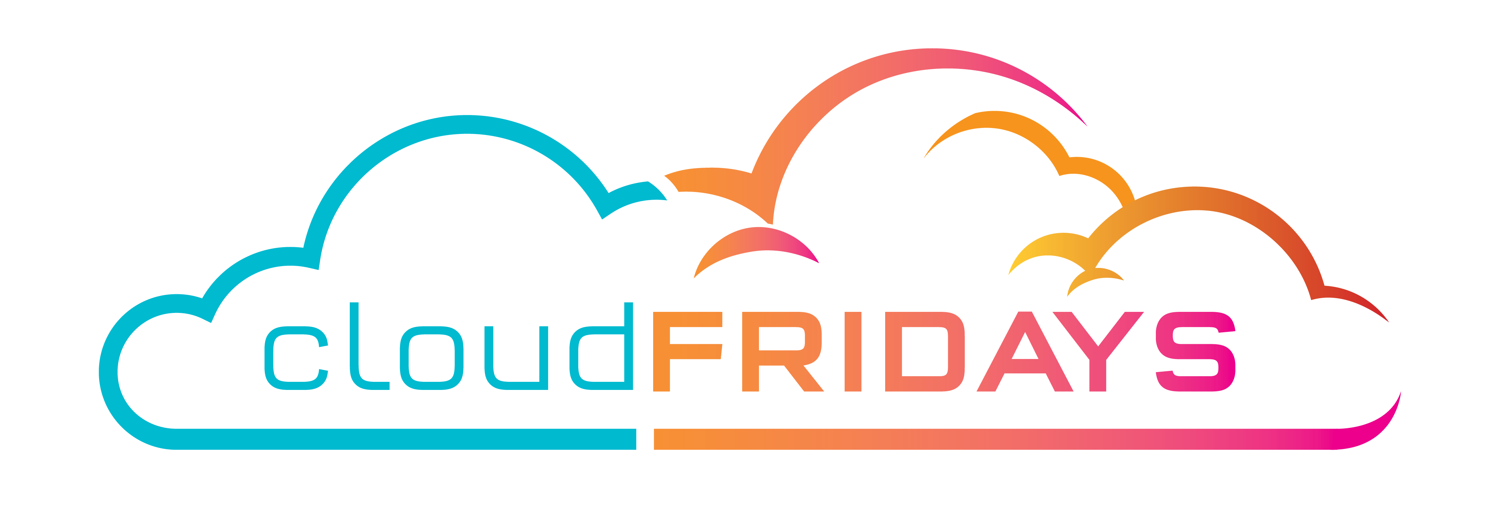

Session title
Subtitle
Speaker Name(s)
Speaker Details(s)

Slide 2
Usage meters
When you provision an Azure resource, Azure creates one or more meter instances for that resource. The meters track the resources' usage, and generate a usage record that is used to calculate your bill.
Notes:
For Example:
Compute Hours
IP Address Hours
Data Transfer In
Data Transfer Out

Slide 3
pricing vary per product and often have different pricing tiers based on the size or capacity of the resource.
Notes:
Check the documentation for specific details on what each service area costs.

Slide 4
The key takeaway is that resources are always charged based on usage. For example, if you de-allocate a VM then you will not be billed for compute hours, I/O reads or writes or the private IP address since the VM is not running and has no allocated compute resources. However you will incur storage costs for the disks.
Note
De-allocating a VM is not the same as deleting a VM. De-allocation means the VM is not assigned to a CPU or network in a datacenter. However, your persistent disks remain, and the resource is present in your subscription. It's similar to turning off your physical computer.

Slide 5
Factors affecting costs
Resource type
Units and Rate depend on Resource Type
Services
First-party rates vs third-party rates
Location
popularity, demand, and local infrastructure costs
Billing Zones
Geographical grouping
Notes:
The usage that a meter tracks and the number of meters associated with a resource depend on the resource type.
The Azure team develops and offers first-party products and services, while products and services from third-party vendors are available in the Azure Marketplace . Different billing structures apply to each of these categories.

Slide 6
Cost Management tools in Azure
Managent Tools
Cost
dadsf
sdfdsafs

Slide 7
Cost Management tools in Azure
Tool | Azure portal | Azure Cost Management | Azure EA Content Pack | Azure Policy
Enterprise Agreement required? | No | No | Yes | No
Budget control | No | Yes | No | Yes
Monitor spending on single resource | Yes | Yes | Yes | No
Monitor spending across multiple resources | No | Yes | Yes | No
Control spending on single resource | Yes - manual sizing | Yes | No | Yes
Enforce spending across multiple resources | No | Yes | No | Yes
Enforce accounting metadata on resources | No | No | No | Yes
Monitor and detect trends | Yes | Yes | Yes | No
Detect spending anomalies | No | Yes | Yes | No
Socialize deviations | No | Yes | Yes | No

